Slide 1

Android
Platform Overview

Slide 2

What is Android?
Android is a software stack for mobile devices that includes an operating system, middleware and key applications.

Slide 3
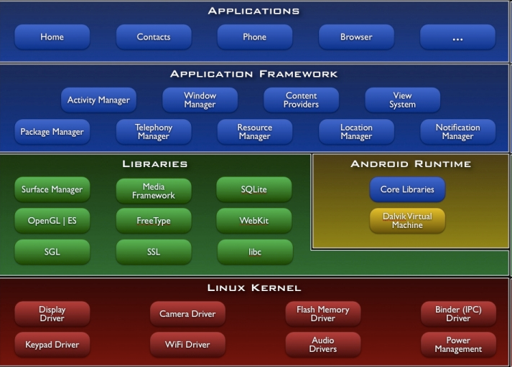
Architecture

Slide 4
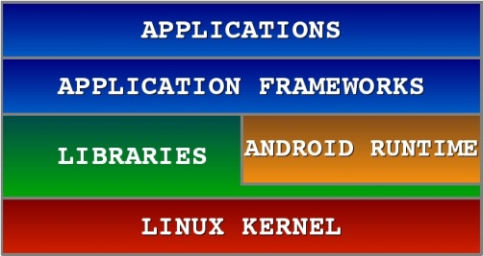


Android S/W Stack - Application
Android provides a set of core applications:
  Email Client
  SMS Program
  Calendar
  Maps
  Browser
  Contacts
  Etc
All applications are produced by the Java Language!

Slide 5
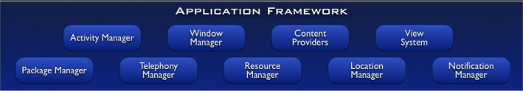
Android S/W App Framework
Enabling and simplifying the reuse of components
  Developers have full access to the same framework APIs used by the core applications.
  Users are allowed to replace components.

Slide 6
Android S/W App Framework
Features
Features | Roles
Views | Used to build an application, including lists, grids, text boxes, buttons, and embedded web browser app
Content Provider | Enabling applications to access data from other applications or to share their own data
Resource Manager | Providing access to non-code resources (localized strings, graphics, and layout files)
Notification Manager | Enabling all applications to display customer alerts in the status bar
Activity Manager | Managing the lifecycle of applications and providing a common navigation backstack

Slide 7
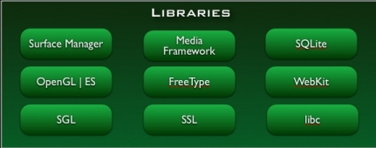
Android S/W Stack - Libraries
Including a set of C/C++ libraries used by components of the Android system
Exposed to developers through the Android application framework

Slide 8
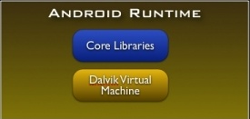
Android S/W Stack - Runtime
Core Libraries
  Providing most of the functionality available in the core libraries of the Java language
  APIs
    Data Structures
    Utilities
    File Access
    Network Access
    Graphics
    Etc

Slide 9
Android S/W Stack - Runtime
Dalvik Virtual Machine
  Providing environment on which every Android application runs
    Each Android application runs in its own process, with its own instance of the Dalvik VM.
    Dalvik has been written such that a device can run multiple VMs efficiently.
  Register based – virtual machine

Slide 10
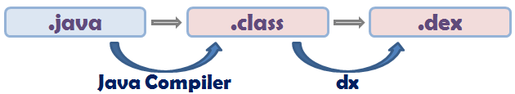
Android S/W Stack - Runtime
Dalvik Virtual Machine (Cont)
  Executing the Dalvik Executable (.dex) format
    .dex format is optimized for minimal memory footprint.
    Compilation
  Relying on the Linux Kernel for:
    Threading
    Low-level memory management

Slide 11
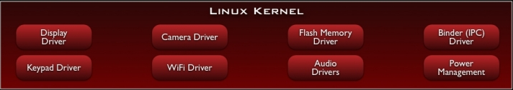
Android S/W Stack – Linux Kernel
Relying on Linux Kernel 4.4.1 for core system services
  Memory and Process Management
  Network Stack
  Driver Model
  Security
Providing an abstraction layer between the H/W and the rest of the S/W stack

Slide 12
Android S/W Stack – Linux Kernel
Android runtime (ART) is the managed runtime used by applications and some system services on Android.
ART as the runtime executes the Dalvik Executable format and Dex bytecode specification.

